Slide 1
How to build an Industry Cost Profile (ICP) for a product in Germany
Identify industry code based on the supplier’s business and product
Step 2
Identify data sources for financial and manufacturing information related to industry code
Step 3
Step 1
Use industry data to calculate ratios for DM, DL, MOH, COGS, GSA & PBT

Slide 2
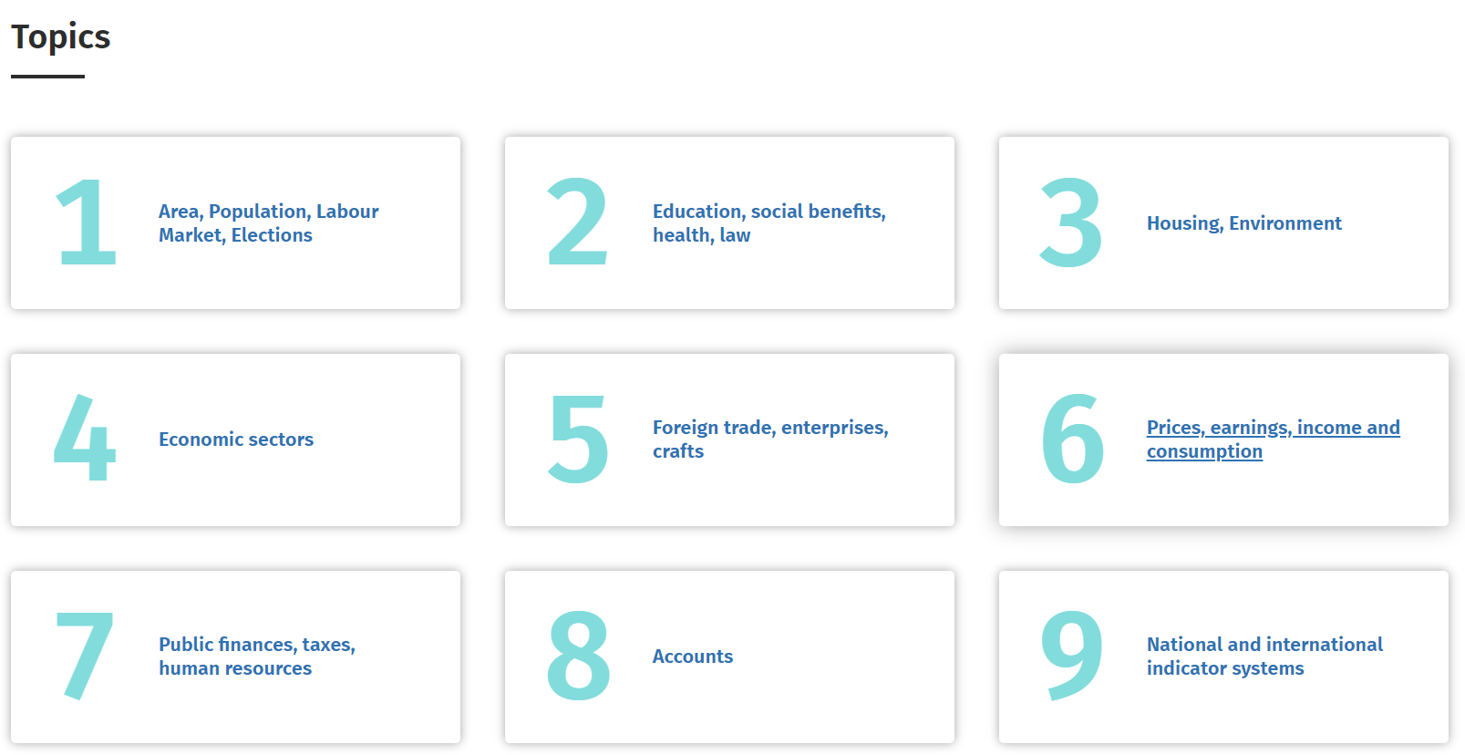
Identify Industry & obtain Financial and Manufacturing Information Related to Industry
Steps 1 & 2
Go to:
Choose preferred language on top right corner.
Click on “Economic Sectors”.
https://www-genesis.destatis.de/genesis/online

Slide 3
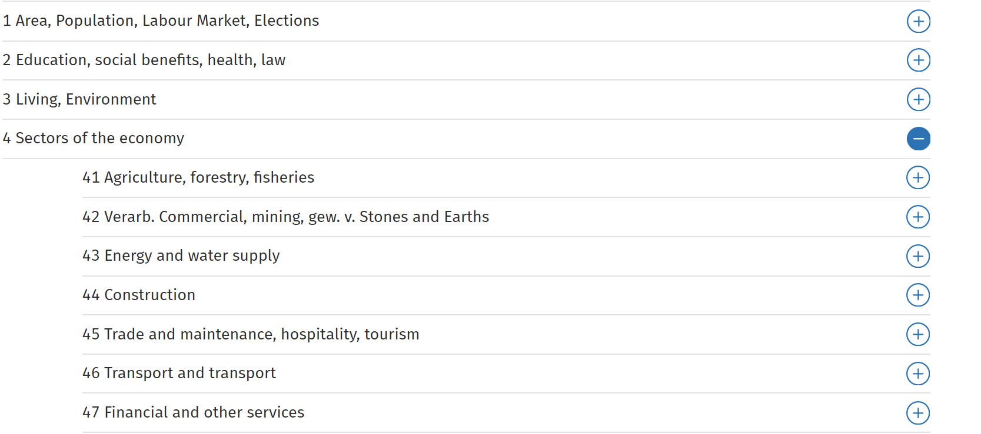
Identify Industry & obtain Financial and Manufacturing Information Related to Industry
Steps 1 & 2
Click on the Industry of interest.
In our example it is “Manufacturing, mining and quarrying”.

Slide 4
Identify Industry & obtain Financial and Manufacturing Information Related to Industry
Steps 1 & 2
Under Themes, click on “422 Structural surveys”.
Next, click on “42251 Cost structure survey in manufacturing, mining”
In the next screen, Under the heading “Tables”, click on “42251-0006 Cost structure of enterprises in manufacturing: Germany, years, economic activities (WZ2008 2-4-digit hierarchy)”.

Slide 5
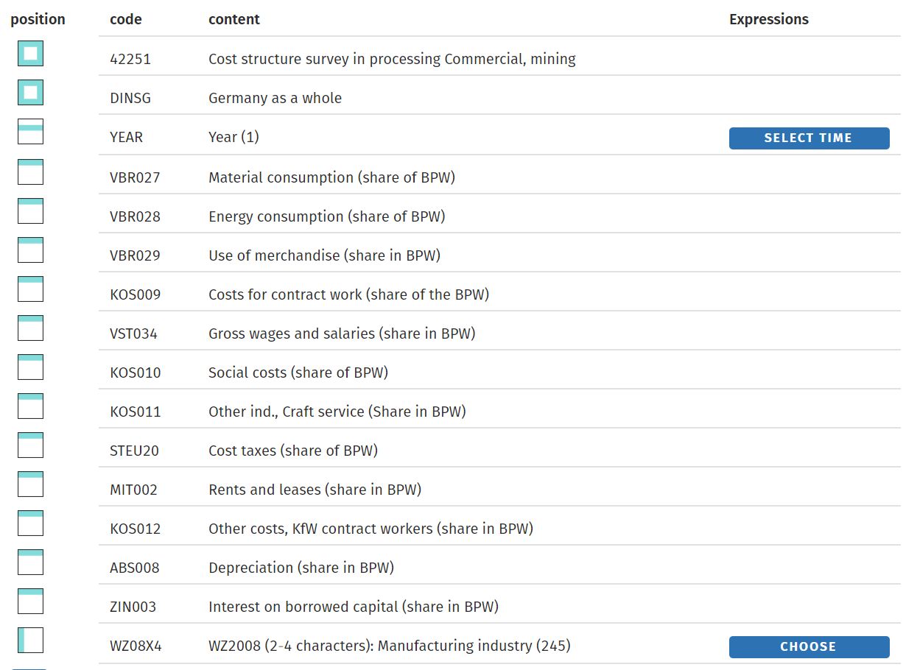
Identify Industry & obtain Financial and Manufacturing Information Related to Industry
Steps 1 & 2
Click on “Choose”

Slide 6
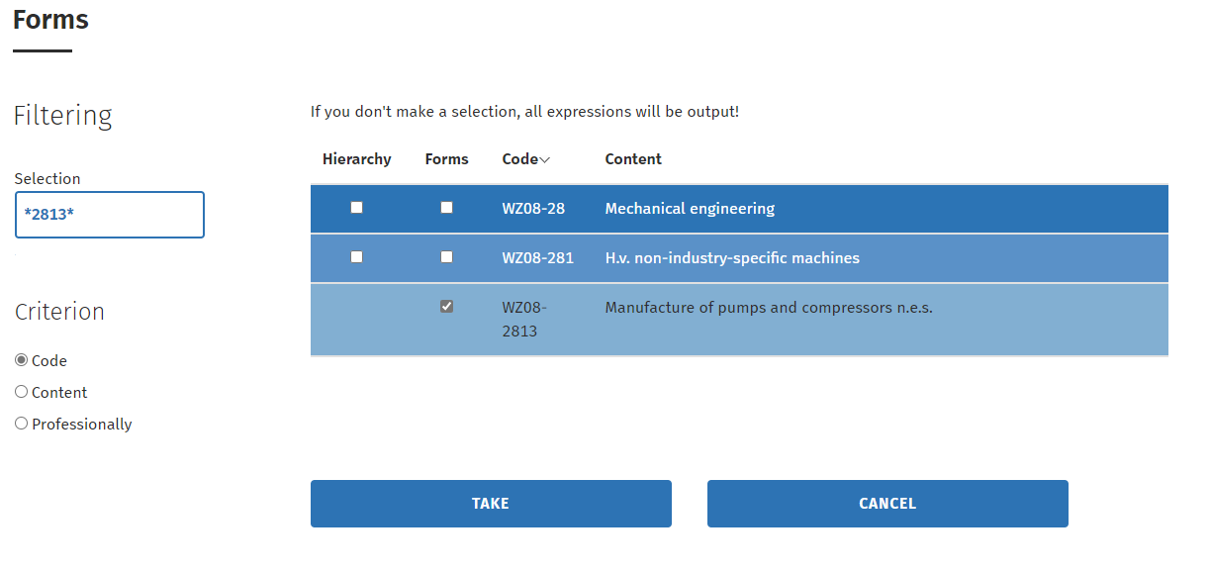
Identify Industry & obtain Financial and Manufacturing Information Related to Industry
Steps 1 & 2
Scroll through the industry codes to choose the exact industry code under Manufacturing.
In this example it is:
“WZ08-2813 Manufacture of other pumps and compressors”
Click on “Take”

Slide 7
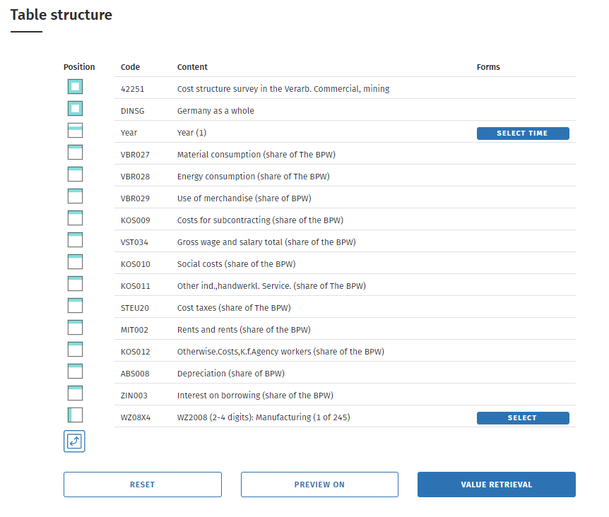
Obtain Financial and Manufacturing Information Related to Industry
Step 2
Click on “Value retrieval”

Slide 8
Obtain Financial and Manufacturing Information Related to Industry
Step 2
Record the values of the following items:
Material consumption (share in gross output) | 43.0
Energy consumption (share in gross output) | 1.0
Use of merchandise (share in gross output) | 4.7
Costs for contract work (share in gross output) | 1.9
Gross wages and salaries (share in gross output) | 22.6
Social security costs (share in gross output) | 5.1
Other services rel. to industry a. crafts (s.i.o.) | 1.9
Taxes (share in gross output) | 0.5
Rents and leases (share in gross output) | 1.3
Other costs, payments for agency workers (s.i.o.) | 11.8
Depreciation (share in gross outp.) | 3.0
Interest on cap. from outside (share in g. output) | 0.6

Slide 9
Obtain Financial and Manufacturing Information Related to Industry
Step 2
Go to:
Choose preferred language on top right corner.
Click on “Economic Sectors”.
https://www-genesis.destatis.de/genesis/online

Slide 10
Obtain Financial and Manufacturing Information Related to Industry
Step 2
Click on the Industry of interest.
In our example it is “Manufacturing, mining and quarrying”.

Slide 11
Obtain Financial and Manufacturing Information Related to Industry
Step 2
Under Themes, click on “421 Short-term surveys”.
Next, click on “42111 Monthly report on manufacturing”
In the next screen, Under the heading “Tables”, click on “42111-0101 Employment and turnover of local units in manufacturing.”

Slide 12
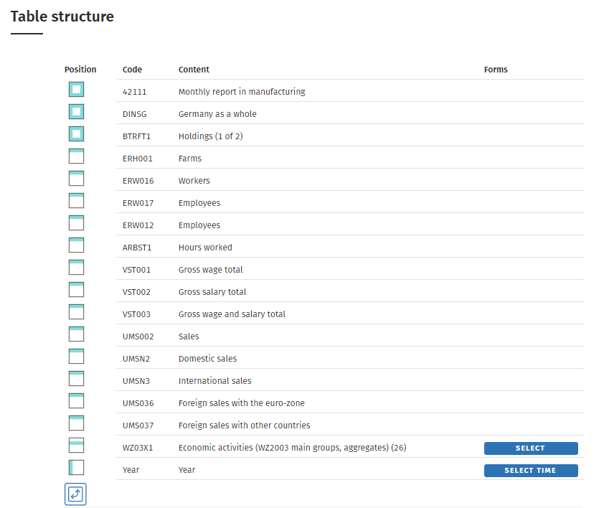
Obtain Financial and Manufacturing Information Related to Industry
Step 2
Click on “Select”

Slide 13
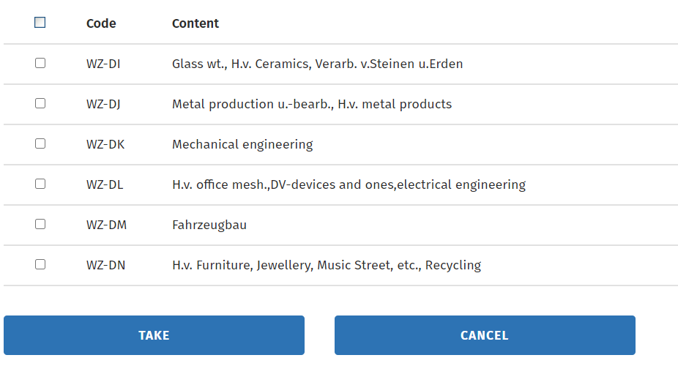
Obtain Financial and Manufacturing Information Related to Industry
Step 2
Scroll through the industry codes to choose the most relevant industry code under Manufacturing.
In our example it is :
“WZ-DJ Manufacture of basic metals, fabricated metal prod.”
Click on “Take”

Slide 14
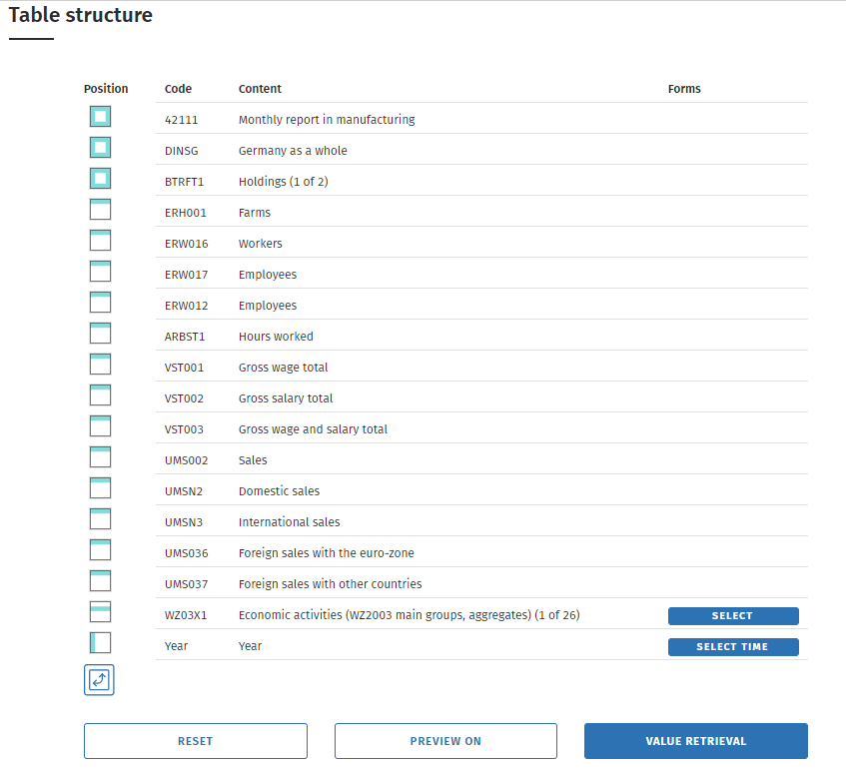
Obtain Financial and Manufacturing Information Related to Industry
Step 2
Click on “Value retrieval”

Slide 15
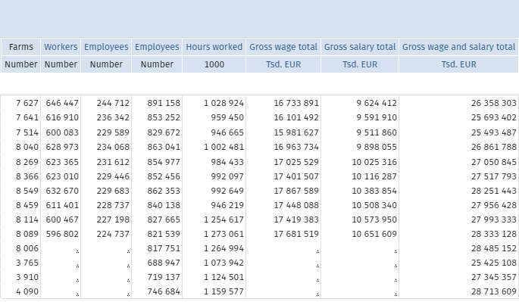
Obtain Financial and Manufacturing Information Related to Industry
Step 2
Record the Direct Labour/Total Labour ratio using formula.
DL/TL= Average( gross wages/Gross Wages and salaries)
Indirect Labour to Total labour ratio= Average( Gross salaries/Gross wages and salaries)

Slide 16
Use Financial and Manufacturing Information to Calculate Ratios
Step 3
1. Calculate the Direct Material (DM) ratio as: Material consumption + Inputs of goods for resale – Energy consumption
(Note: in this statistical data the “Energy consumption” value is included in the “Material consumption” value)
2. Calculate Direct Labor to Total Labor ratio (DL/TL)
1.
 | Material consumption | 43.0
 | Input of goods for resale | 4.7
 | Energy consumption | 1.0
 | Direct Material (DM) | 46.7%
 | Average gross wage (DL) | 17,681,519
 | Average gross wages and salaries (TL) | 28,333,128
 | DL/TL | 62.4%
2.

Slide 17
Use Financial and Manufacturing Information to Calculate Ratios
Step 3
3. Calculate Total Labor ratio (TL) as: Gross wages and salaries + Social security costs
4. Calculate Direct Labor ratio (DL) as: ((DL/TL ratio)* Total labor)+ Cost of contract work
 | Gross wages and salaries | 22.6
 | Social security costs | 5.1
 | Total Labor (TL) | 27.7%
 | Direct Labor (DL) | =0.624*27.7
 | Cost of contract work | 2
 | Direct Labor (DL) | 19.3%
3.
4.
Notes:
Korea-
Basic Metal Manufacturing
COGS 116,108,609
DM 79,607,506
DM/COGS=68%

Slide 18
Use Financial and Manufacturing Information to Calculate Ratios
Step 3
5. Calculate Manufacturing Overhead (MOH) as:
6. Calculate Indirect Labour contribution to SGA
5.
 | Energy consumption | 1.0
 | Other services rel. to industry a. crafts | 1.9
 | Rents and leases | 1.3
 | Depreciation fixed assets | 3.0
 | MOH | 7.2%
 | Total Labor | 100
 | Direct Labor | 62.4
 | Indirect Labor as % of TL | 37.6%
 | Indirect Labor | =0.376*27.7
 | Indirect Labor contribution to SGA | 10.4%
Energy consumption + Other services rel. to industry a. crafts +Rents and leases + Depreciation fixed assets (Consumption of fixed capital)
6.

Slide 19
Use Financial and Manufacturing Information to Calculate Ratios
Step 3
7. Calculate SGA as:
8. Calculate Profit Before Tax (PBT) as:
7.
 | Other costs | 11.8
 | Taxes | 0.5
 | Interest on cap. from outside | 0.6
 | Indirect Labor to SGA | 10.4
 | SGA | 23.3
 | DL | 19.3
 | DM | 46.7
 | MOH | 7.2
 | SGA | 23.3
 | Total | 96.5
 | PBT | =100-96.4
 | PBT | 3.5%
Other costs + Interests on borrowing + Indirect Labor to SGA
8.
100- SGA-MOH-DL- DM

Slide 20
Present all your calculated ratios in the cost breakdown format
Industry cost profile for “Pump manufactring in Germany”
 | Direct Material (DM) | 46.7%
 | Direct Labor (DL) | 19.3%
 | Manufacturing Overhead (MOH) | 7.2%
 | Cost of Goods Sold (COGS) | 73.2%
 | SGA & Other Expenses | 23.3%
 | Profit Before Tax (PBT) | 3.5%
 | Total Sales | 100.0%
Ratios calculated from ”GENESIS-Online Datenbank”

Slide 21
 | Germany | China | Taiwan | India
Direct Material | 46.7% | 48.5% | 48% | 59.68%
Direct Labor | 19.3% | 4.9% | 8.3% | 4.29%
MOH | 7.2% | 34.2% | 17.7% | 22.28%
Cost of Goods Sold | 73.2% | 87.6% | 74% | 86.25%
SG&A | 23.3% | 7.8% | 15% | 7.43%
PBT | 3.5% | 4.6% | 11% | 6.32%
Total | 100% | 100% | 100% | 100%

